Slide 1
Lecture 10
Logical Fallacies

Slide 2
Last Lecture
Whether to accept an inductive argument, it is decided by inductive strength.
Inductive strength is like deductive validity, looking to the form/structure of argument.
An inductive argument is strong, given that the conclusion is probably derived from the premises. It is weak, given that the conclusion is probably derived from the premises.
An inductive argument is cogent, given that it is strong and its premises are true.

Slide 3
Logical Fallacy
Formal
Informal
Invalid
Fallacies of Irrelevance
Fallacies of Insufficient Reasons
Weak

Slide 4
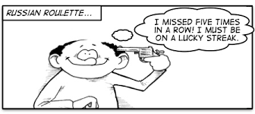
Logical Fallacies
Logical Fallacy:
The given premises cannot guarantee the conclusion being true
Containing mistakes on form or content

Slide 5
Logical Fallacies
(1) Formal (Form / Structure)
Invalid: true premises cannot guarantee the conclusion being true.
Weak: true premises make the conclusion being probably false
(2) Informal (Content)
Reasons are problematic.
Premises are irrelevant.
P1. If I’m laugh loudly, then there will be an earthquake.
P2. There is no earthquake.
C. Hence, I do not laugh loudly.
It is valid, but still has informal fallacy!

Slide 6
Logical Fallacies
Informal Fallacies
Fallacies of Irrelevance
The premises are logically irrelevant to the conclusion
Fallacies of Insufficient Reason
The premises fail to provide sufficient reason

Slide 7
Premise 1
Premise 2
Conclusion
…
Premise 1
Premise 2
Conclusion
…
Supporting Reason/ Evidence are irrelevance
Supporting Reason/ Evidence are not enough

Slide 8
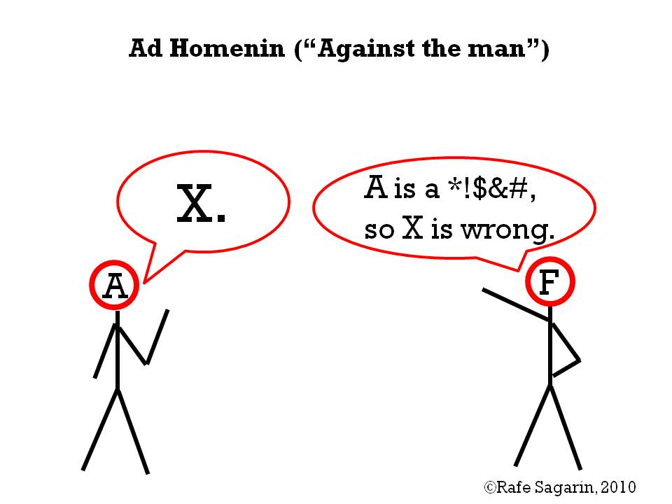
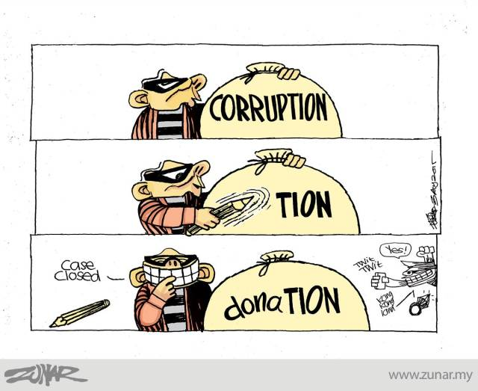
(1) Personal Attack (Ad Hominem)
Reject the argument by attacking the person
The person who offers argument has problematic character.
Pattern:
P1: X has problematic character.
C: Therefore, X’s argument cannot be true
Prosecutor: Your honour, since A is a thief, therefore his testimony cannot be trusted!
Opposition: Najib is the king of donation. So he cannot lead the country.

Slide 9
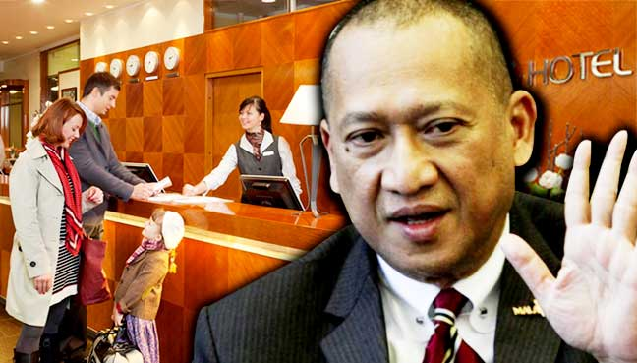
(2) Attacking the Motive
Criticizing someone’s motivation for offering argument
People with biases or questionable motives do offer good arguments
Pattern:
P1: X is biased or has questionable motives.
C: Therefore, X’s argument or claim should be rejected.
Nazri has argued in favor of Tourism Tax. But why should we listen to him. As a Minister, he absolutely supports the policy.
Najib: The opposition tries to used 1MDB issue to topple the country. Therefore, people should not continue to discuss on 1MDB.

Slide 10
(3) Look Who’s Talking (Tu Quoque)
Dad: You should quit smoking.
Son: I’ll quit when you do, dad!
Reject the argument simply that person fails to practice what he preaches.
Arguments are good or bad not because of who offers them
Pattern:
P1: X fails to follow his or her own advice.
C: Therefore, X’s claim or argument should be rejected.
Dewan Rakyat Deputy Speaker Nga Kor Ming is in no position to talk about integrity when he himself had failed to honour his election promise, to distribute freehold land titles to all Chinese new villagers in Teluk Intan during the Lunar New Year celebrations. (from MCA website)
Najib: The government should make sure everyone are treated fairly and lawfully.
People: He has no position to request for this because he fail to do so too!

Slide 11
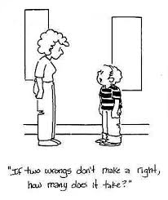
(4) Two wrongs make a right
To justify a wrongful act by claiming that some other act is just as bad or worse
Make excuse
Pattern:
P1: Everyone do X
C: Therefore, doing X is not wrong.
Jimmy stole Tommy’s lunch in the past. Therefore, it is acceptable for Tommy to steal Jimmy’s lunch today.
Why can’t I break the traffic rules? Other people do the same thing.

Slide 12
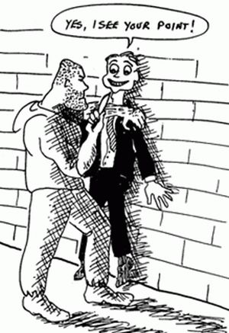
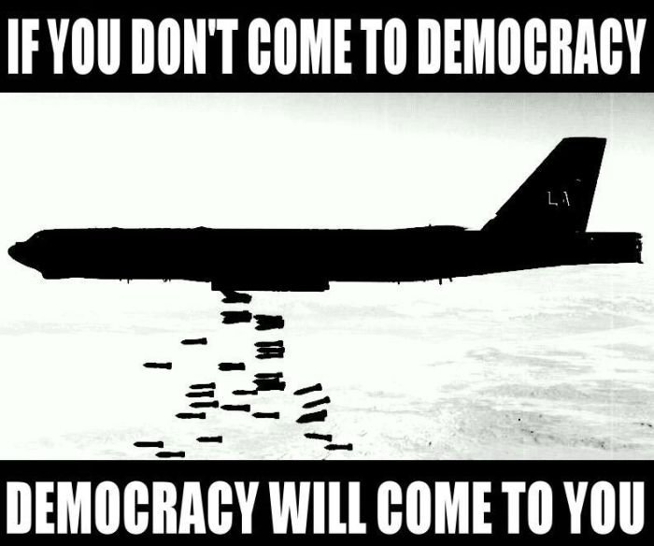
(5) Appeal to Force
Threatens harm to a reader or listener
This threat is irrelevant to the truth of the arguer’s conclusion
Scare tactics provide no relevant evidence that supports the conclusion.

Slide 13


(6) Appeal to Emotion
Use emotional appeals to hinder or obscure rational thinking
Such feelings are not logically relevant to the arguer’s conclusion
Anger, pity, compassion, guilty, etc.
Lawyer: There is no doubt that my client committed to murder. But she comes from a poor family and a tough life. Therefore, she is not guilty.

Slide 14
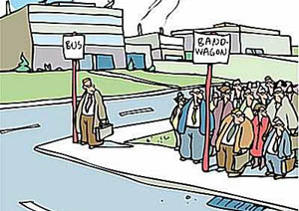
(7) Bandwagon Argument (Following the popularity)
Plays on a person’s desire to be popular, accepted, valued
A belief or a practice is popular usually provides little or not evidence that the belief is true or that the practice is good.
Common in advertising
Pattern:
P1: Everybody believes or does X.
C: Therefore, you should believe or do X, too.
I can’t believe you’re going to the library. You don’t want people to think you are a nerd, do you?
Now everyone vote for Pakatan Harapan. Why you still insist to vote for Barisan Nasional?

Slide 15
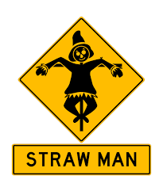
(8) Straw man Fallacy
Distorts someone’s argument in order to make it easier to attack
Make the argument seem weaker or less plausible than it really is
Pattern:
X’s view is false or unjustified. Therefore, X’s view should be rejected.
A: The Prime Minister has nominated Tommy Thomas a new Attorney General. I agree with this nomination because Tommy is an expert and quite experience on our legal system.
B: I can’t believe that you agree with a non-Muslim and betray Malays.

Slide 16
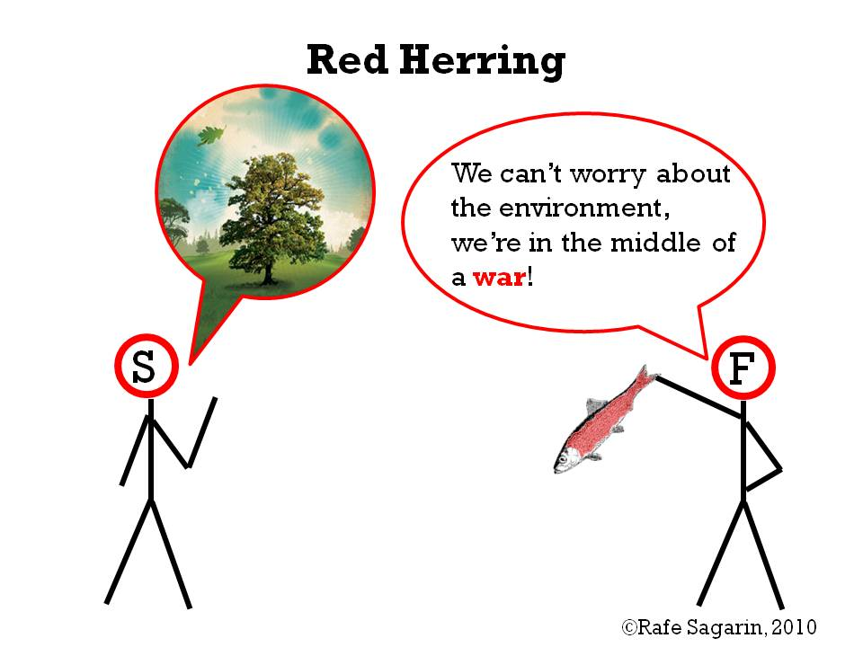
(9) Red Herring Fallacy
Try to sidetrack his or her audience by raising an irrelevant issue
Claim that the original issue has effectively been settle by the irrelevant diversion
Changing or evading the issue
The situation becomes worse as the terror attacks happened frequently. Therefore, United Kingdom should withdraw from European Union in order to protect own benefits..

Slide 17
Fallacy of Equivocation
A key word is used in two or more senses in the same argument
The apparent success of the argument depends on the shift in meaning
It could be a valid argument
Example:
Science has discovered many laws of nature. This surely constitutes proof that there is a God, for wherever there are laws, there must be a lawgiver. Consequently, God must exist as the Great Lawgiver of the universe.

Slide 18
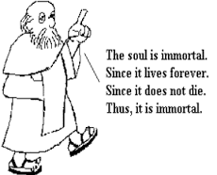
Begging the Question
Arguer assumes the point to be proven
(a) restate the conclusion in different word
With synonym
(b) circular reasoning
The conclusion of the argument is stated or assumed as one of the premises
Capital punishment is morally wrong because it is unethical to inflict death as punishment for a crime.

Slide 19
Fallacies of Irrelevance
Personal attack
Attacking the motive
Look who is talking
Two wrongs make a right
Appeal to force
Appeal to emotion
Bandwagon argument
Straw man Fallacy
Red herring Fallacy
Fallacy of Equivocation
Begging the question

Slide 20
Fallacies of Insufficient Reasons
Premise 1
Premise 2
Conclusion
…
Supporting Reasons/ Evidences are not enough

Slide 21
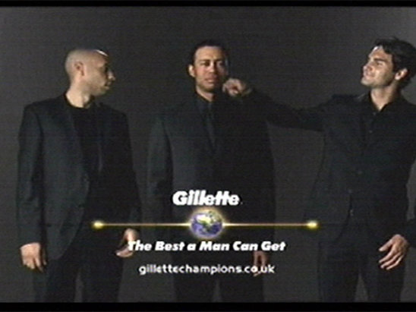
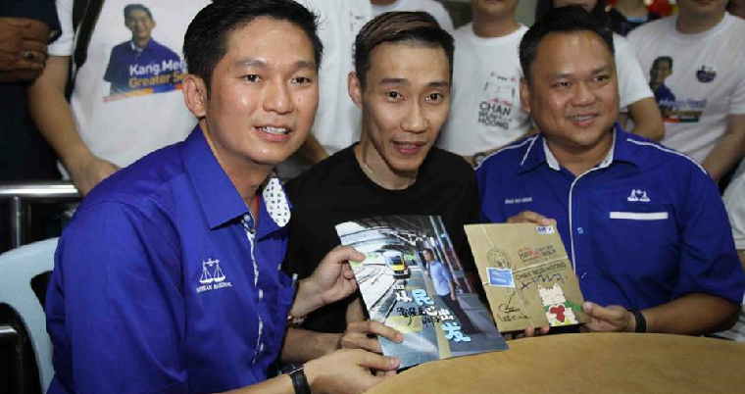
(1) Appeal to Authority
Reliable & Trustworthy
Authority = person with special knowledge, expertise
Citing a witness or an authority that is untrustworthy would become a fallacy.
Pattern:
X is an authority, so what X says must be true.
Induction: Argument from Authority

Slide 22
(1) Appeal to Authority
Not genuine authority: Unreliable authority on the subject at issue Biased source: Unreliable source or motive Inaccuracy: Doubtful observations or experiences Unreliable: Disreputable source | Incorrect cited: False citation Conflict with expert opinion: Against overwhelming majority of experts Unsettled by appeal to expert opinion: Controversial issue Highly improbable
My barber told me that Einstein’s theory of relativity is a lot of hogwash. I guess Einstein wasn’t as smart as everybody thinks he was.
Datuk Lee is the hero of our country. We should follow Datuk Lee to support BN.

Slide 23
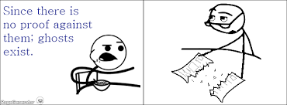
(2) Appeal to ignorance
Treating a lack of evidence as positive evidence
We could prove any conclusion we want!
The burden of proof is on the arguer.
Pattern:
It is true that X, because no one has proven that X is false.
Exceptions:
Fruitless search
Legal system (Benefit of Suspicious)
Since no one has proved that Najib did not get involved in 1MDB scandal. Therefore, he get involve in 1MDB scandal.

Slide 24
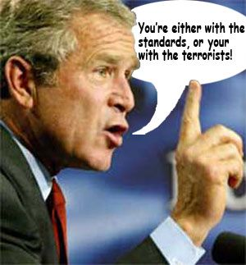
(3) False Alternatives (False Dichotomy; False Dilemma)
Posing a false either/or choice
Pattern:
P1: Either A or B
P2: Not A
C: Therefore, B
Either we elect a liberal and democrat party or the nation continues to corrupt. Obviously, we don’t want nation to corrupt. Therefore, we elect a liberal and democrat party.
Deduction: Disjunctive Argument

Slide 25
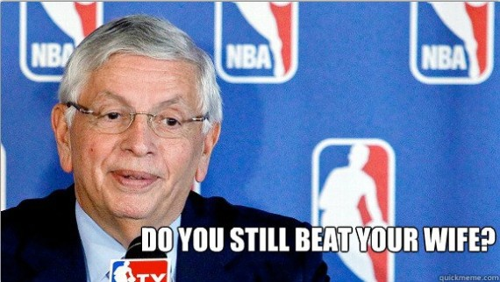
(4) Loaded Question
Posing a question that contains unfair or questionable assumption
Without justification on that presupposition
Rolling several questions into one.
Any direct yes or no answer will force to admit something not want to admit.
Joe: Have you stopped cheating on exams?
Girlfriend: When are you going to stop acting so immature?

Slide 26
(4) Loaded Question
Joe: Have you stopped cheating on exams?
Question 1: Did you ever cheat on exams?
Question 2: If you did cheat on exams in the past, have you stopped now?
Example:
Why do politicians find it so difficult to be honest and integrity?
The only reason is that they want to win the supports from the people anyway. This is the only way they achieve.

Slide 27
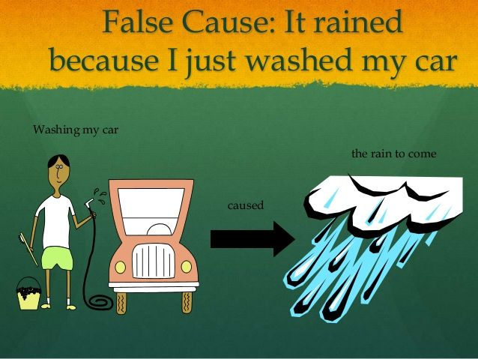

(5) Questionable Cause
Claiming, without sufficient evidence, that one thing is the cause of something else
(a) post hoc fallacy
Pattern:
P1: A occurred before B
C: A is the cause of B
Induction: Causal Argument

Slide 28
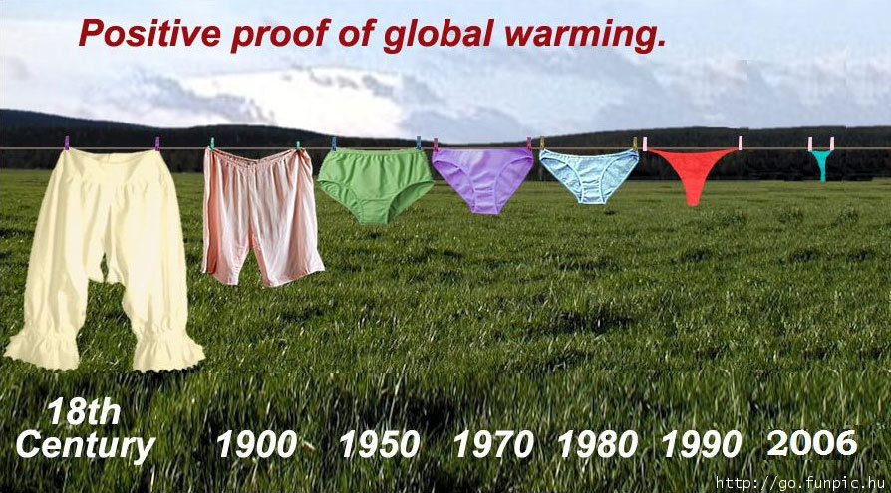
(5) Questionable Cause
(b) the mere correlation fallacy
Pattern:
P1: A and B regularly occur together
C: A must be the cause of B
(c) the oversimplified cause fallacy
That A is the sole cause of B
But there are several causes of B
Campus bullying are increasing. Obviously, current laws and policies are not strict and tough enough.

Slide 29
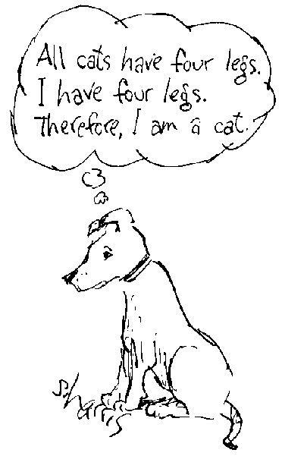
(6) Hasty Generalization
Drawing a general conclusion from a sample that is biased or too small
Sample: too small, unrepresentative
Example:
We asked more than ten thousand scientists at colleges and universities throughout the country. Less than 40 percent said they never consume in internet. Therefore, e-commerce does not work in Malaysia.
Induction: Inductive Generalization

Slide 30
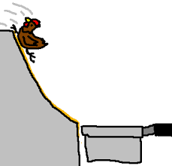
(7) Slippery Slope
Claiming a seemingly harmless event is followed by other related events.
This will finally lead to a disastrous outcome.
Pattern:
P1: If a certain seemingly harmless action, A, is permitted, A will lead to B, B will lead to C, and so on to D
P2: D is a terrible thing
C: Therefore, there is no reason to hold A

Slide 31

(7) Slippery Slope
We should legalize same-sex marriage. But allowing same-sex marriage would undermine respect for traditional marriage. Traditional marriage is the very foundation of our society. If that foundation is destroyed, our whole society will collapse. Thus, if we want to prevent the complete disintegration of our society, we must oppose the legalization of same-sex marriage.
Problems of Slipper Slope:
Is the conclusion really bad?
Is the conclusion likely to follow?
Do the costs outweigh the benefits?

Slide 32
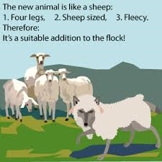
(8) Weak Analogy
Comparing two (or more) things that are not really comparable
Pattern:
P1: A has characteristics w, x, y, and z
P2: B has characteristics w, x, and y
C: Therefore, B probably has characteristic z, too
Why does a taxer pay taxes to the government if the ruling party loses the state election. This is like paying cigarette taxes even though you don’t smoke.
Induction: Analogy Argument

Slide 33
(9) Inconsistency
Asserting inconsistent premises, asserting a premise that is inconsistent with the conclusion, or arguing for inconsistent conclusions
Inconsistent means two statements are in contradiction (can not be true at the same time)
Moral absolutist: I can’t believe that members of the Mabunga tribe still practice child sacrifice. If anything is absolutely and universally wrong, it’s child sacrifice.
Moral relativist: Hey, get with the times, man! All value judgments are relative. And that’s the absolute truth.

Slide 34
What Have We Done?
Argument
Constructing Argument
Verifying
Finding Logical Indicators
Finding Premises and Conclusion
Formalizing the Argument
Validity & Strength
Informal Fallacies

Slide 35
Fallacies Full List
Fallacies of Insufficient Reasons | Fallacies of Irrelevance
Inappropriate Appeal to Authority Appeal to Ignorance False Alternatives Loaded Question Questionable Cause Hasty Generalization Slippery Slope Weak Analogy Inconsistency | Personal attack Attacking the motive Look who is talking Two wrongs make a right Appeal to force Appeal to emotion Bandwagon argument Straw man Fallacy Red herring Fallacy Fallacy of Equivocation Begging the question

